Slide 1
CRIMINAL JUSTICE
PROGRAM REVIEW 2021

Slide 2
Program Instructors
Tim King
  28 years law enforcement experience
  M.S. Criminal Justice/Homeland Security
  B.S. Criminal Justice
  Police management, supervision, and field experience
Josh O’Dell
  17 years law enforcement experience
  B.S. Criminal Justice
  Police management, supervision, and field experience

Slide 3
Criminal Justice Career Fields
Police Officer
County Sheriff
State Trooper
Federal Agent
Corrections Officer (local, state, and federal)
Juvenile Officer
Probation and Parole Officer (state and federal)
Department of Natural Resources Officer
Private Security Officer

Slide 4
Importance to Students
Careers
Stability
Diversity
Benefits

Slide 5
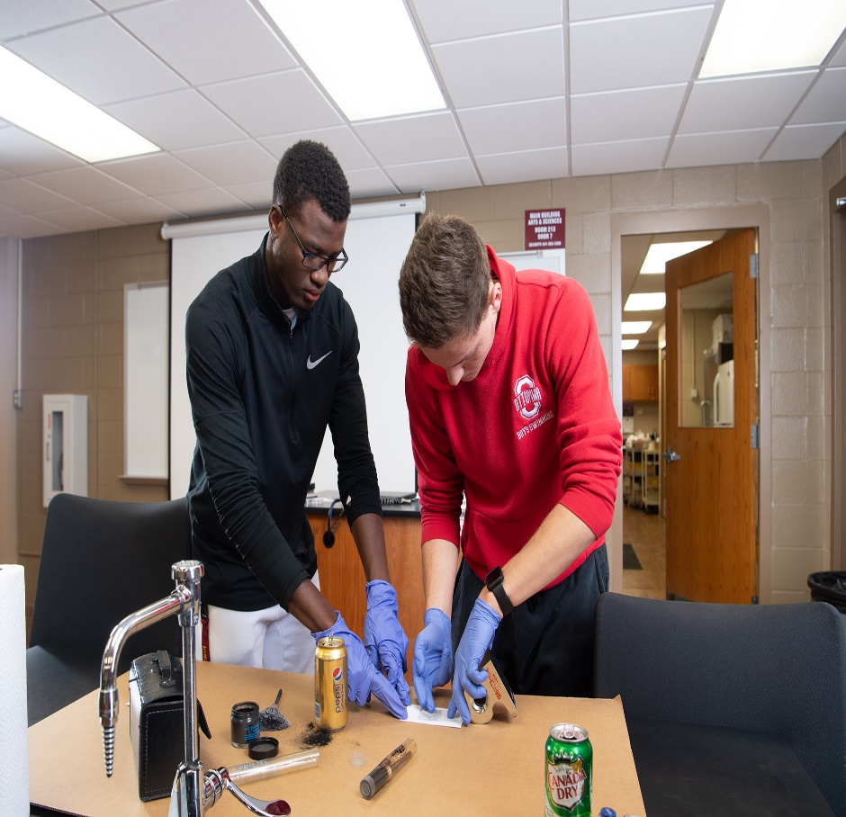
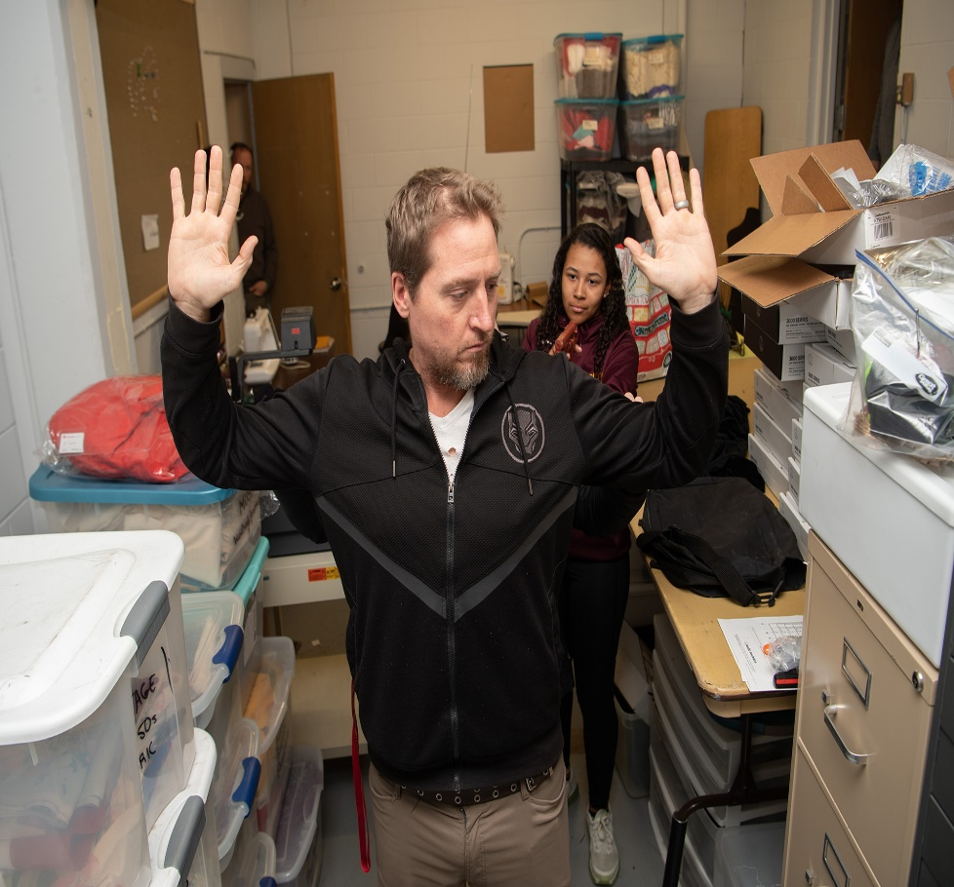
Importance to Students:
Career Training

Slide 6

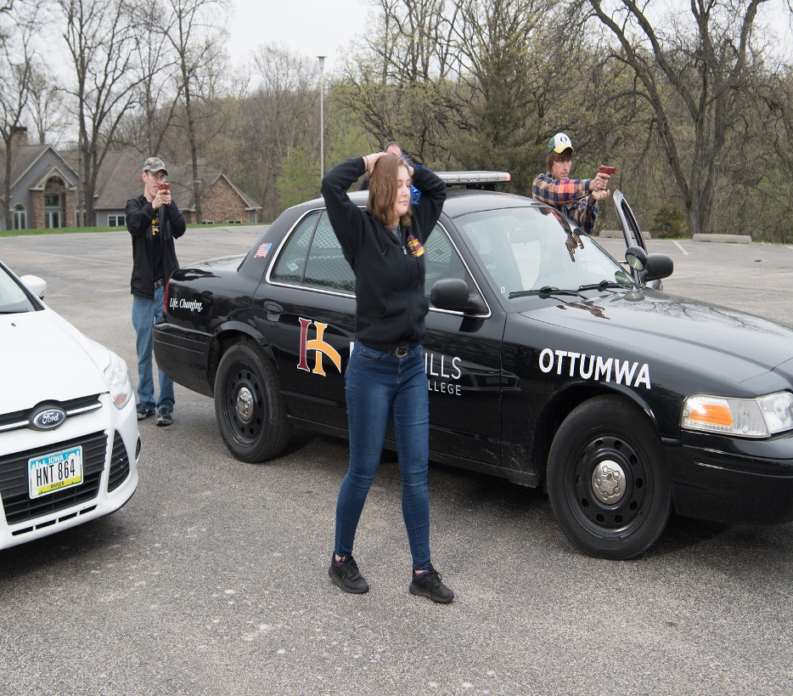
Importance to Students:
Career Training

Slide 7
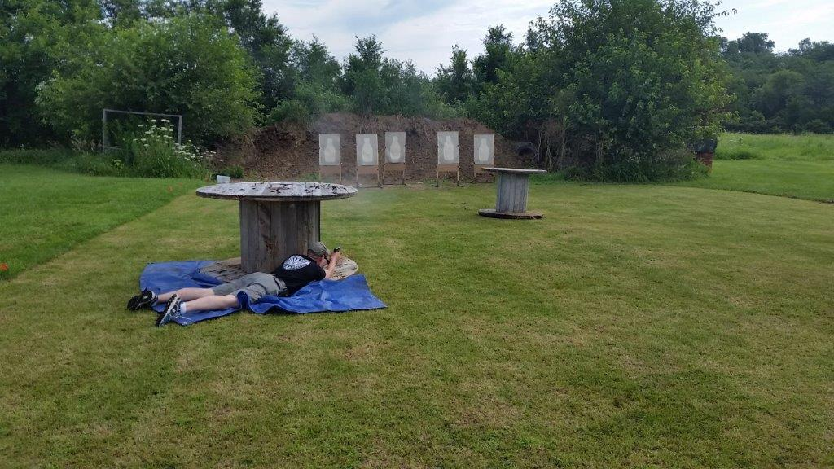
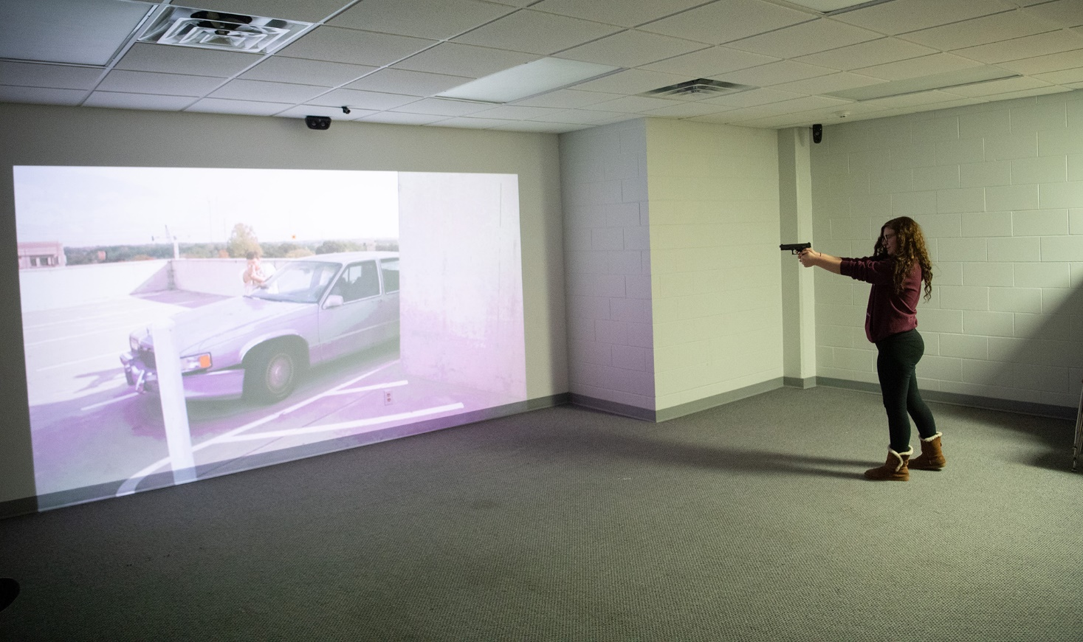
Importance to Students:
Career Training

Slide 8
Importance to the Community and College
Ottumwa Oktoberfest Parade- Volunteers
Ottumwa Area Highway Clean Up- 2x/ year
IHCC Warrior Christmas
Providing continuous training to IHCC security staff.
Women in Law Enforcement Conference
Various security issues for runs and events in the community.

Slide 9
Importance to the Community and College
Continuing Education for LE/College Faculty and Staff
  Implicit bias/de escalation (new law changes)
  Use of Force
  Various hosted schools
  Simulator
Working towards regional academy status

Slide 10
Graduate Placement 2012-2017
Clinton PD
Lucas County SO
Chariton PD
Appanoose County SO
Mahaska County Jail
Wapello County Jail
Centerville PD
Oskaloosa Police Dept.
Marion County Jail
Pella PD
Clark County MO. SO
Monroe County Jail
Henry County SO
Ellsworth Correctional Facility KS
American Home Finding- Juvenile Shelter
Iowa State Capital Police

Slide 11
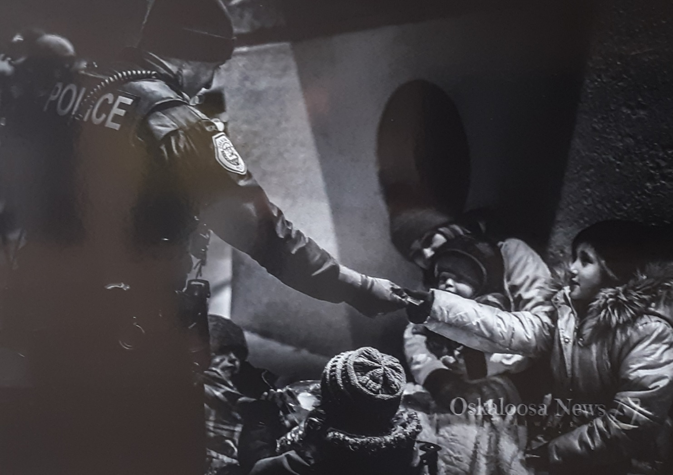
Importance to Students
Career Training

