Slide 1
Centerville Campus Project
June Board Meeting

Slide 2
“The process of saving money helped us create a better building”
Moving structure “inside” campus
Keeping dirt on campus to widen road
Lowering ceiling one foot
Multiple windows in library instead of curtain wall
Landscaping

Slide 3
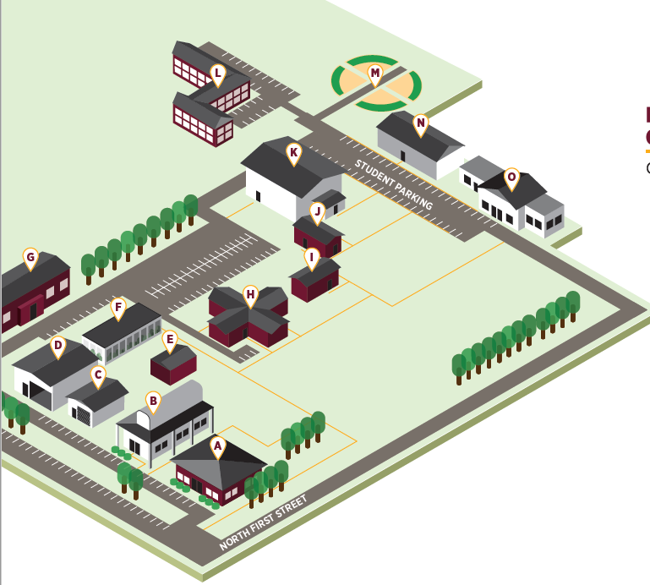
IHCC Centerville for 2022-2024

Slide 4
All classes will be on campus… with a few exceptions
Science Labs (Mondays only at Centerville HS)
HS Health Science Academy (all day at the mall)
Nursing (all day at the mall)
The only trailers on campus are for contractors, NOT students ☺

Slide 5
Questions?

