Slide 1

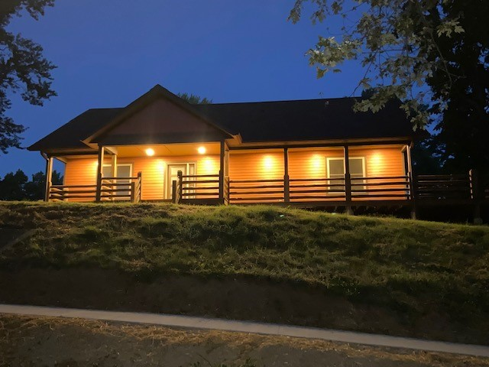
Indian Hills Construction Tech.

Slide 2
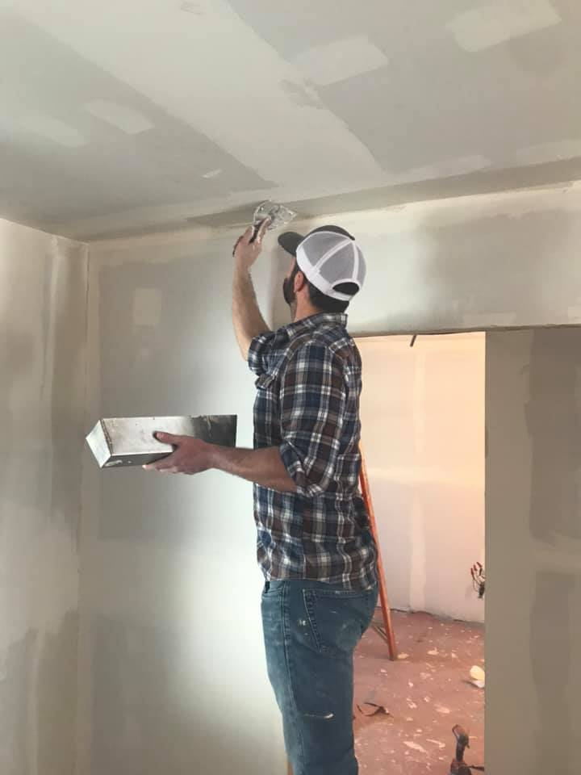
What programs/paths do we have to offer:
Concurrent – Dual enrollment with High School Instructors
Academies – Dual enrollment with IHCC Instructors
Construction Trades – Centerville and Ottumwa
Construction Tech - Centerville

Slide 3
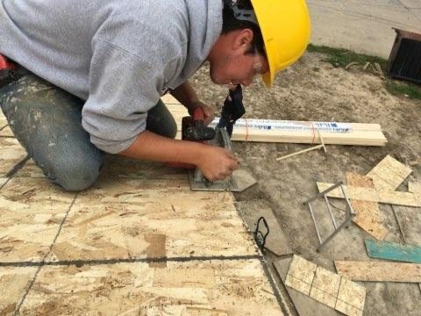
Construction Tech has really grown!
Centerville Campus Program
Ottumwa Campus Program
Academy Programs:
  Ottumwa
  Centerville
  Chariton
Concurrent Programs:
  Fairfield
  Oskaloosa
  Van Buren Co.

Slide 4
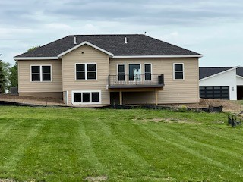
Concurrent Programs
Oskaloosa
  15 Students
  New home construction
Fairfield
  6 Students
  Partnering with Habitat for Humanity
Van Buren
  10 Students
  Smaller Projects

Slide 5
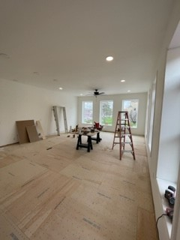
Academies
Centerville
  10 Students
  Integration with Traditional Program
  for New Home Construction
Chariton
  8 Students
  Remodel projects transitioning
  into New Home Construction
Ottumwa
  18 Students
  New Home Construction

Slide 6
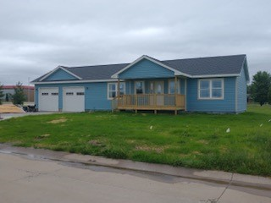
Construction Trades – 1 YR Diploma
9 Traditional students this past year
Most Students go this route so they can start work quickly
Our goal with our 1 yr diploma is to give a general knowledge of all aspects of residential construction
Students working for:
  McAninch Corp.
  Wolf Construction
  Graham Construction
  IBEW Local 347
  Self employed
  Lockridge Lumber
  Ervin Masonry

Slide 7
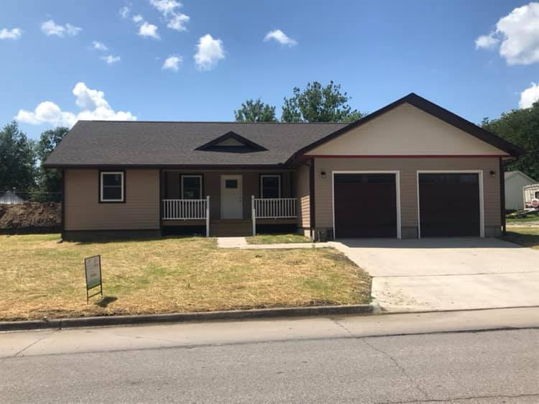
Construction Tech – 2 YR AAS
9 Students this past year
Dive deeper with courses like print reading, residential wiring, plumbing, and introduction to building science
The past 2 years we have students moving to/starting at:
  University of Northern Iowa
  Rathbun Rural Water
  Christner Contracting Inc.
  Alliant Energy
  J & S Remodeling
  Evers Construction
  Danley Construction

Slide 8
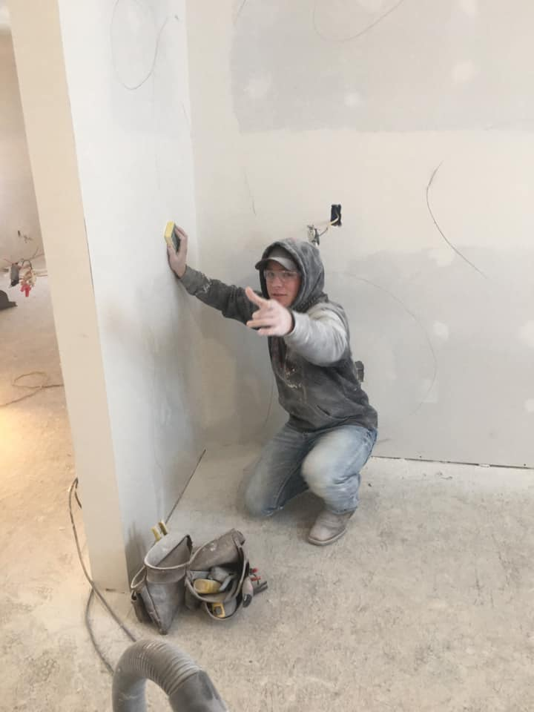
Next Steps,…
Continue to grow the programs by:
  Improving our processes
  Staying relevant with industry technology
  Strengthen relationships with area contractors
  Construct 5 house this coming school year!!
Continue to produce great well-rounded Students
to fill industry needs.

Slide 9
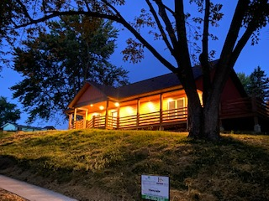
Any Questions?

