Slide 1
Auto Technology

Slide 2
Program Update Overview
(Student Learning Outcomes)
Enrollment 59
Moved to online interactive curriculum
New paint and new equipment
New Classrooms
New Partnerships
Course and Lab improvements have raised student learning almost 40%
The Future of Auto Technology

Slide 3
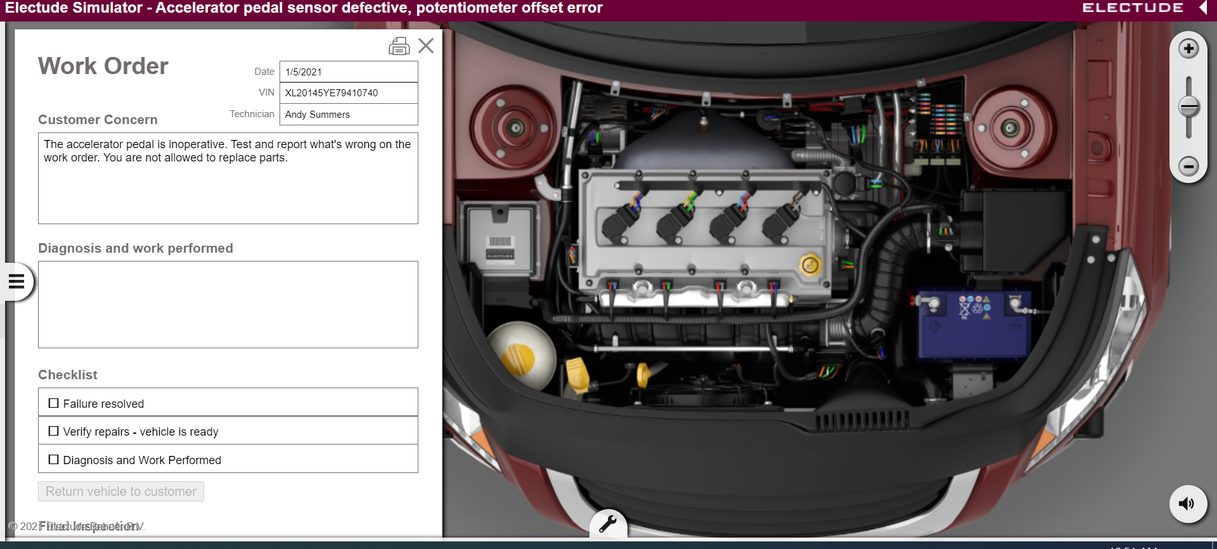
Electude Online
Electude Simulator - Accelerator pedal sensor defective, potentiometer offset error

Slide 4
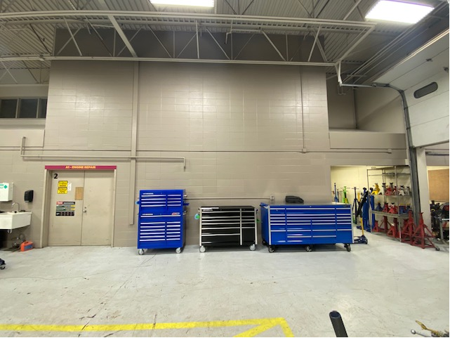
New Paint in our main lab

Slide 5
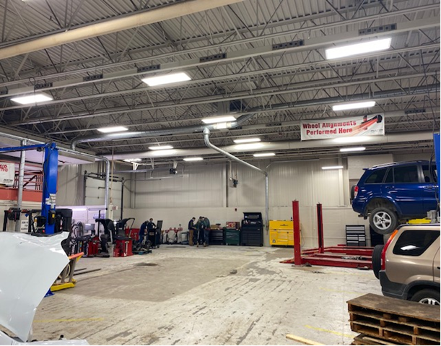

Slide 6
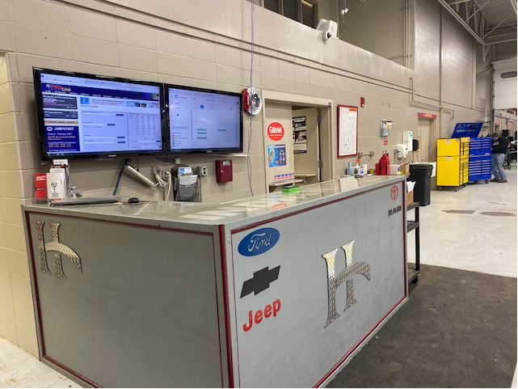
Customer Service Desk

Slide 7
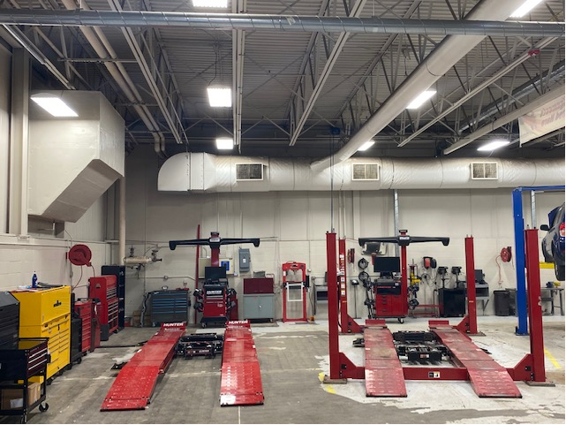
Capital equipment

Slide 8
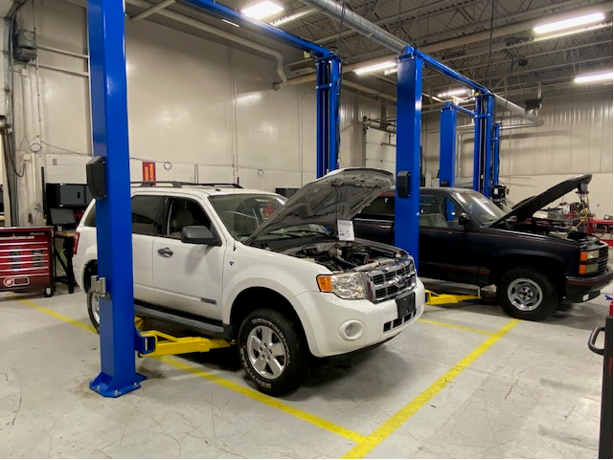
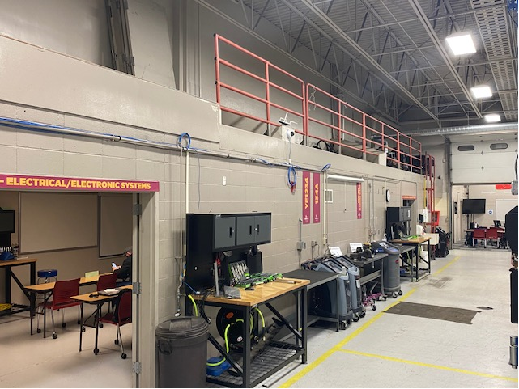
Training Lab (old Diesel lab)

Slide 9
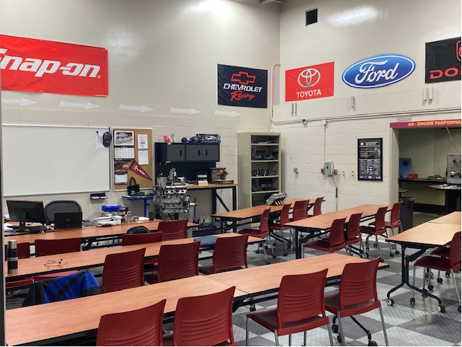
Classroom 1 (old Diesel engine room)

Slide 10
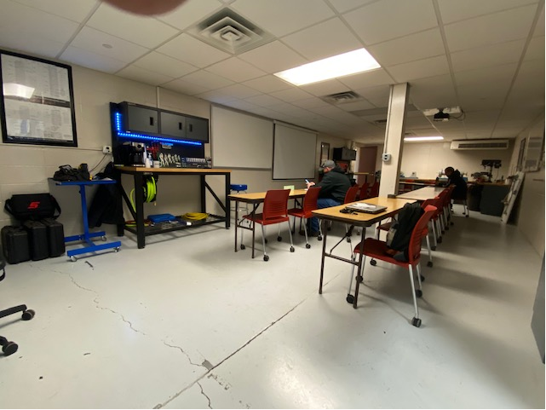
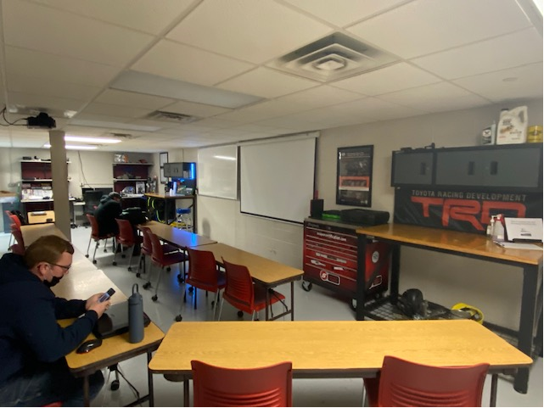
Classroom 2 (old Industrial Maintenance room)

Slide 11





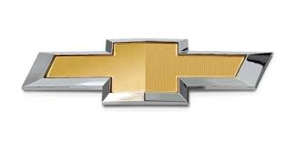
New Partnerships
Coming later this year.

Slide 12
Learning Improvements
Attached classrooms have saved over 1.5 hours per day of travel time between spaces.
Electude online means the students can prep at home and come to class ready to work.
New equipment and new training spaces have allowed us to set up over 3 times the amount of workstations as previously possible.

Slide 13
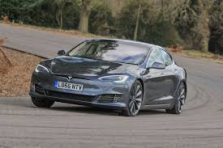
The Future of Auto Technology
642,000 Technicians needed between 2020-2024. (TechForce Foundation)
Advanced Autonomous cars will not be able to fix themselves. They will also require more maintenance by skilled technicians.

Slide 14
We have helped over 1000 students get to class over the last two years.
We have helped over 600 Faculty and Staff get to work in the same two years.

Slide 15

Thank you!

