Slide 1
Dr. Jennifer Wilson
Vice President, Business Solutions
February, 2022

Slide 2
Business Solutions Division
Vice President
Business Solutions
REC/SBDC
Iowa Works
GAP & PACE
Pathway Navigators x 2
Business Liaisons x2
Ottumwa Career Planners x 2
Counselor, SBDC
Administrative Assistant, REC
Marshalltown Career Planners x 2
ABE/ESL Director
Credit/Non-credit
Instructors
Administrative Assistant, CEWS
Operations Director, CEWS
Service Center Supervisor
Health Continuing Education Coordinator
C.N.A. Instructor
AHA Instructor
SIM/EMS Instructor
Career/WBL
WBL Coordinator
Service Center Site Staff
Continuing Education Coordinator
CPT Instructor
Job Corp Grant Staff

Slide 3
Economic Vitality
futuristic and innovative lens by responding to the evolving needs of students, communities, and businesses
work collaboratively with faculty and staff to research, develop and expand workforce education opportunities for credit and non-credit programs
find sustainable solutions to meet the workforce challenges of the region

Slide 4
Community Engagement
South Central Iowa Workforce Board
Businesses (new/expansion)
Non-profits
PreK-12’s
Government

Slide 5
Division Rationale
Develop a business solutions framework
  Increase customized offerings
  Variation of program structure to increase revenue opportunities
  Develop program efficiencies
Statewide Leadership
  Multi-disciplinary approach
  Legislative/Governor oversight

Slide 6
Creative program development/redesign to meet workforce needs
  Alignment of credit/non-credit programming
  Increase communication between credit/non-credit
  Develop a stronger pathway “system” for students
  Increase opportunities for credit for prior learning
  Grow academic opportunities to meet workforce needs

Slide 7
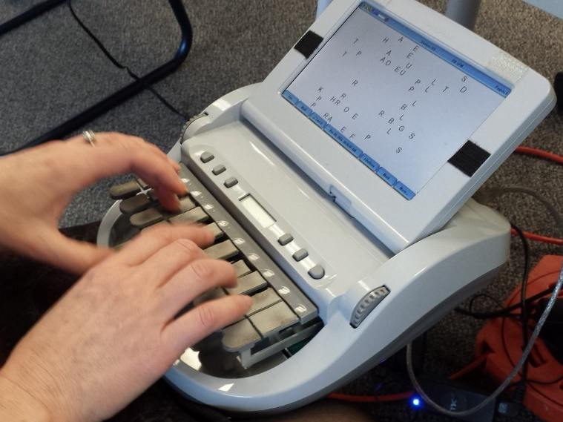
Project update
Court Reporting and Captioning Program
  Met with advisory team
  Curriculum/program development
  Submitted program intent to DE

Slide 8
Questions?

