Slide 1
Perkins V
December 14, 2020
Dr. Jennifer Wilson

Slide 2
Carl D. Perkins
Strengthening Career and Technical Education (CTE) for the 21st Century Act
To develop academic, technical and employability skills for students who elect to enroll in career and technical education programs
Authorized by the federal government in 1984 and reauthorized in 2018

Slide 3
Perkins V Federal Objectives
Develop academic and technical standards for high skill, high wage, and in-demand occupations in current or emerging professions
Link secondary and postsecondary CTE programs
Increase flexibility in providing services and activities to implement, develop, and improve CTE programs
Conduct and disseminate national research on best practices
Improve leadership and professional development for high quality faculty
Support partnerships: secondary, postsecondary, CTE schools, local workforce investment boards, business and industry, etc.
Provide education and training programs to keep the United States competitive
Increase employment opportunities for populations who are chronically unemployed or underemployed

Slide 4
Major Changes
Aligned more with the Workforce Innovation and Opportunities Act and Higher Education Act
  Employment and training services for:
    adults, dislocated workers, and youth and Wagner-Peyser employment services administered by the U.S. Department of Labor (DOL)
  Assist with obtaining employment for:
    adult basic education, family literacy and Vocational Rehabilitation populations administered by the U.S. Department of Education (DOE)
Changes to performance accountability
  Improve the performance of underserved students

Slide 5
Performance Accountability
Post-program retention and placement
Earned Recognized Postsecondary Credential
Non-traditional Program Concentration

Slide 6
IHCC’s Grant Development Process
Evaluated programs using a needs assessment
Collaborated with advisory boards on performance, equipment, and curriculum needs
Evaluated local, regional and state high-demand, high-wage careers data
Reviewed previous performance levels collected
Utilized capital equipment process to determine innovation/equipment needs

Slide 7
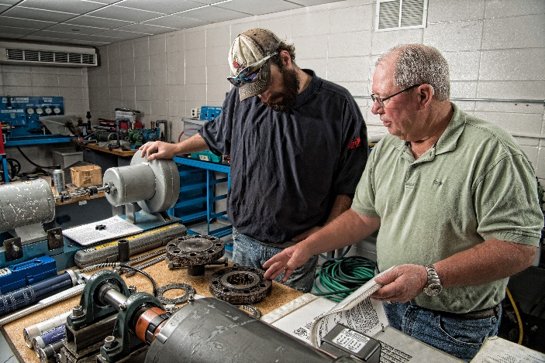
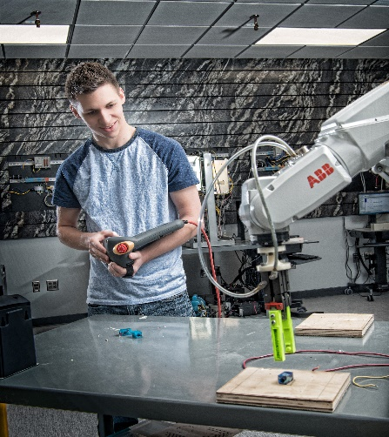
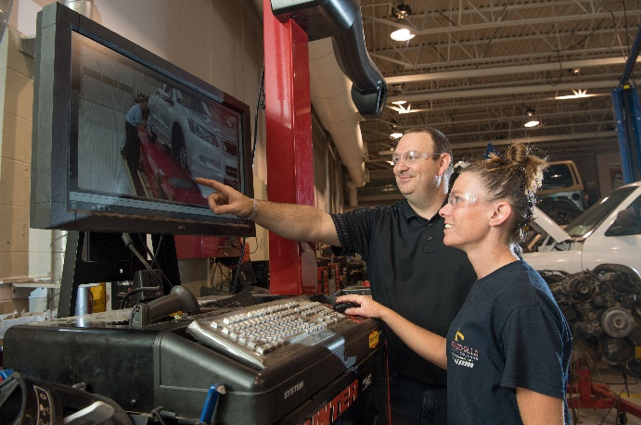


2020-21 Targeted Programs
Auto
Diesel
Robotics
Industrial Maintenance
Welding

Slide 8

Grant Summary
IHCC will use Perkins funds to increase enrollment in CTE high-wage/in-demand programs, provide academic support for CTE students to ensure they are retained and complete their program, provide technical support to faculty to enhance innovation, and increase diversity within faculty, students, and special populations within CTE programs.

Slide 9
IHCC’s Perkins V Grant Objectives
Purchase new equipment.
Assist students in career planning, tutoring, enrollment and advising.
Assist faculty with use of technology and assessment, alignment of curriculum labor force needs, and credentialing development of technical skills.
Expand enrollment non-traditional career opportunities for students (i.e. females in trades, males in healthcare) and to students who do not traditionally enter college upon high school graduation (i.e. alternative learning students).
Expand diversity within our CTE programs.
Expand Work-based learning opportunities.

Slide 10
IHCC Funding: $296,534.86
Teaching & Learning Specialist positions
Equipment $100,000
  Six Axis Industrial Robot w/MIG Welding Package
  Laser Shaft Alignment unit
  Multipurpose Scan Tool
Academic support services
  (2 FTE @ 25%)
Career Exploration and Development
  OTT & CTRV
  (2 FTEE @ 80%)

Slide 11
Questions??

