Slide 1
Dental Hygiene
12-14-2020

Slide 2
Program Enrollment
  Retention rate from 2017-2020
  4 years – 98% retention rate
  2020 – started with 19 – currently have 19

Slide 3
Employment
  5 year average 100%
Employment Outlook from the US Bureau of Labor and Statistics
  Overall employment of dental hygiene is projected to grow 19% percent from 2016 to 2026, faster than the average for all occupations.
  Annual Salary median range in Iowa $67,000

Slide 4
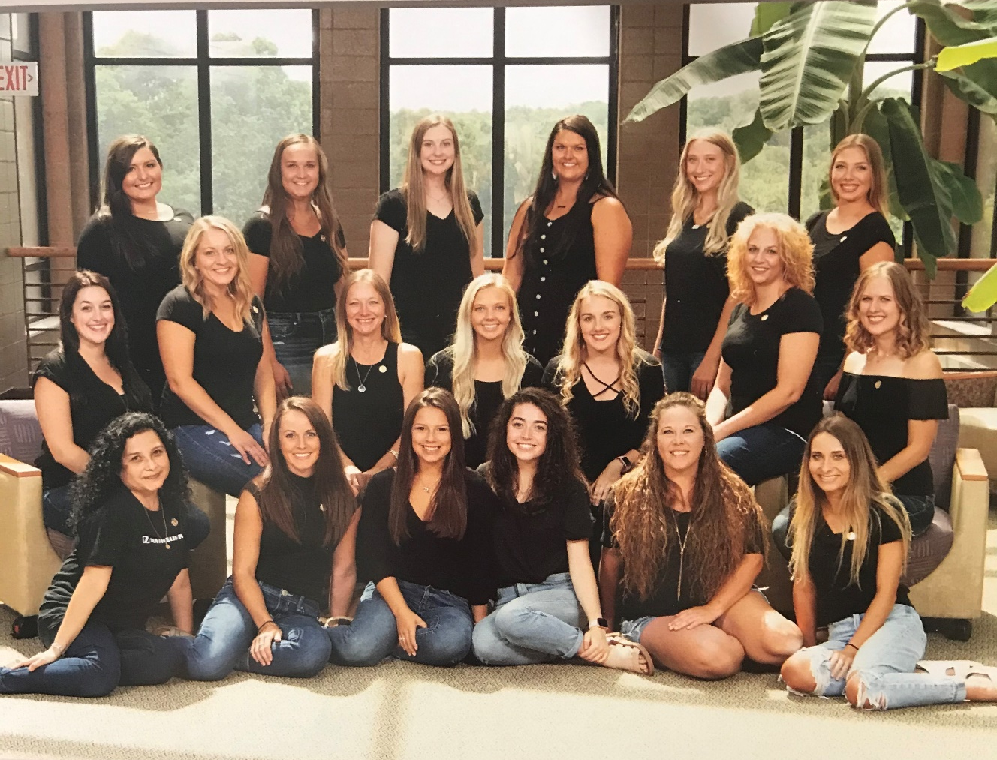
Dental Hygiene Class of 2020

Slide 5
Comments from Graduate Follow-Up Survey
  Class of 2017-2020
    I’m glad that I went through dental hygiene at IHCC. I have recommended friends to go to IHCC for dental hygiene.
    I am so thankful for what the instructors have done for me during COVID. I was able to graduate and start my career as planned.

