Slide 1
A Statewide Partnership
Helping Iowa Manufacturers Seize the Opportunity

Slide 2
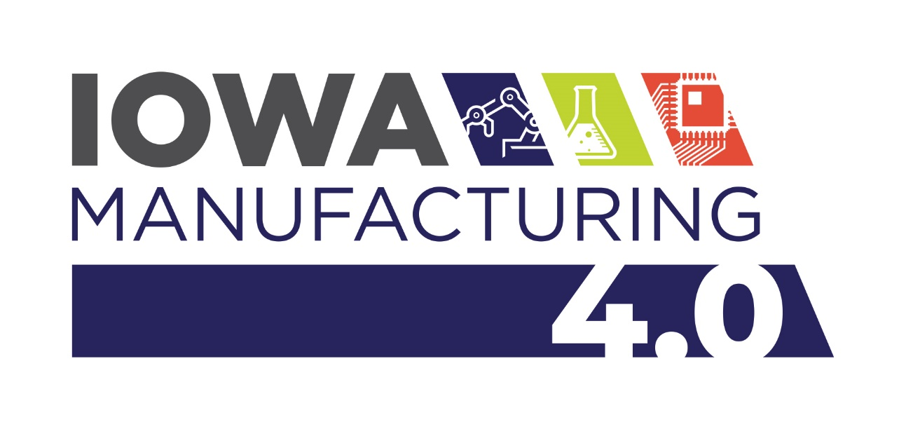
Iowa Manufacturing Consortium
Support for the Manufacturing Sector
  Training & Awareness Initiative
Statewide Partners:
  Iowa’s Community Colleges
  Iowa State’s Center for Industrial Research & Service (CIRAS)
  Iowa Economic Development Authority
  Institute for Decision-Making, University of Northern Iowa
  Association of Business and Industry
  Iowa Department of Education
  Iowa Workforce Development
  Professional Developers of Iowa
Develop curriculum to meet training needs
Customized training for the existing workforce
Develop/enhance certificate, diploma & degree programs
Educate/inform Iowa’s leaders

Slide 3
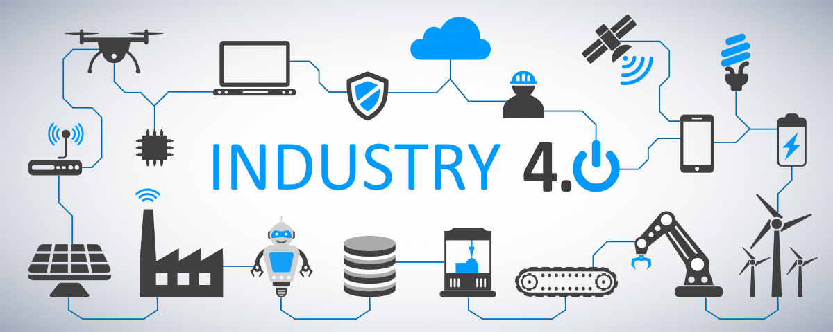
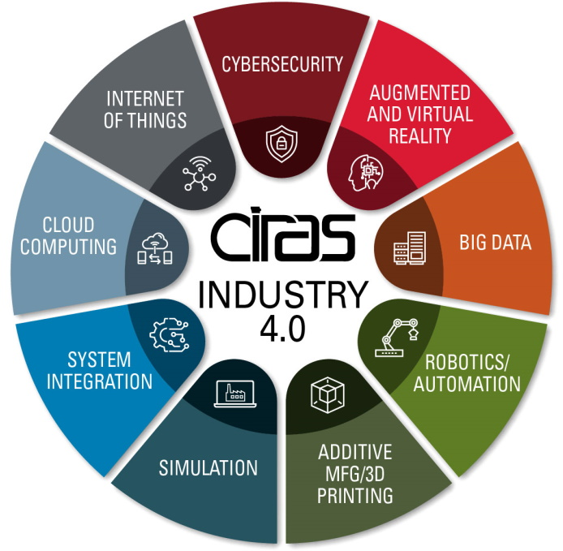
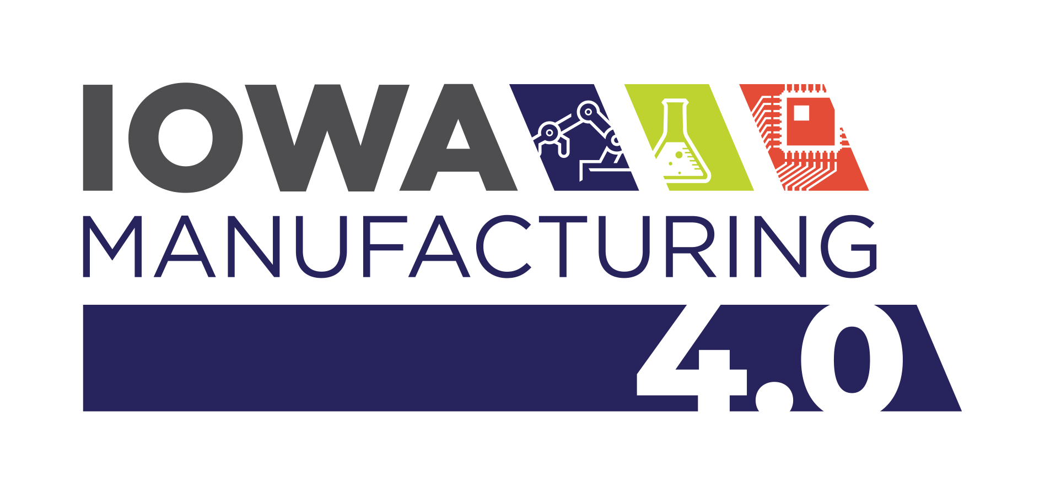
What are we talking about today?
3
STEP
VIDEO
https://youtu.be/IMmnSZ7U1qM
Industry (or Manufacturing) 4.0 is:
  9 Technologies or Applications Working Together
  Smart Manufacturing – Connected Supply Chains
  Cyber Physical Systems (integration or interaction of physical equipment and software)

Slide 4
Adoption Support
Iowa Economic Development Authority (IEDA) Grants
  Manufacturing Industrial Internet of Things (IIoT) Infrastructure Investment Grants
    Up to $25,000 for the purchase of specialized hardware or software in the Industry 4.0 technology groups.
  Manufacturing Innovation Equipment Grants
    Up to $50,000 for the purchase of specialized equipment aimed at helping manufacturers increase productivity, efficiency and competitiveness.
  Notes:
    Fewer than 75 FTEs (across all locations)
    NAICS Code 31-33
    1-1 Cash Match
    Manufacturing 4.0 Assessment from CIRAS – (free)
    Can apply for both programs
Community College 260 Programs
  Retraining existing workforce
  Increase in this year’s 260F funding

Slide 5
Timeline
Late July - Early August - Pilot Intro Workshop for Companies
July-Sept. – Awareness Sessions
September - IEDA application opens
January 2022 – Training
CIRAS is booking assessments now
IHCC is taking 260F application now

Slide 6
Questions?

