Slide 2
Educational Talent Search Banquet 2018

Slide 3
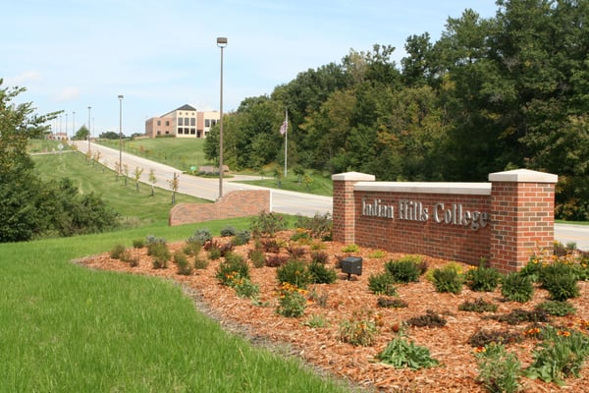
Erlinda Aldaba Justice Finch
Shadije Aliu Nayeli Juarez
Pablo Alvarado LuLu Lopez
JD Carapia Olivia Lunsford
Xavier Cottrell Ariana Nunez
Jonathan Clubb Anahi Rodriguez
Anahi Diaz Brendon Saunders
Austin Dudley Makala Shoop
Nahom Gebremedhin

Slide 4
Leslie Bahena
Bryan Forero
Steven Garcia
Wendy Houston
Collin Kepner
Lauren Madren

Slide 5
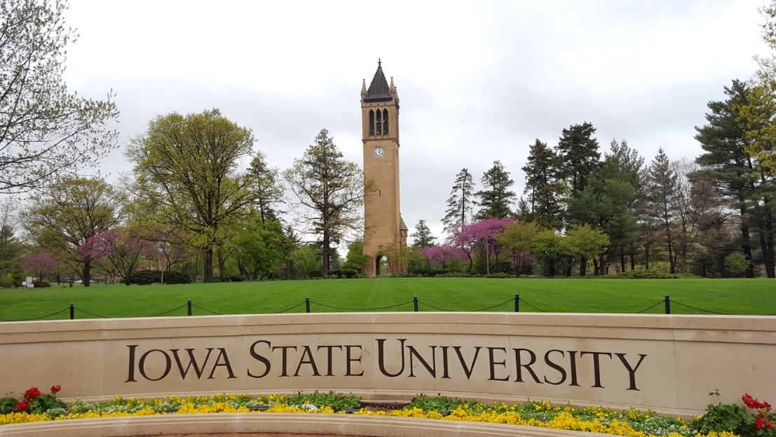
Hannah Jeffrey
Wesley Melendez
Anthony Segovia
Jarhett VanEngelenhoven

Slide 6
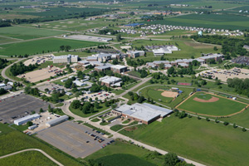
Chloe Hartley
Jacob Young

Slide 7
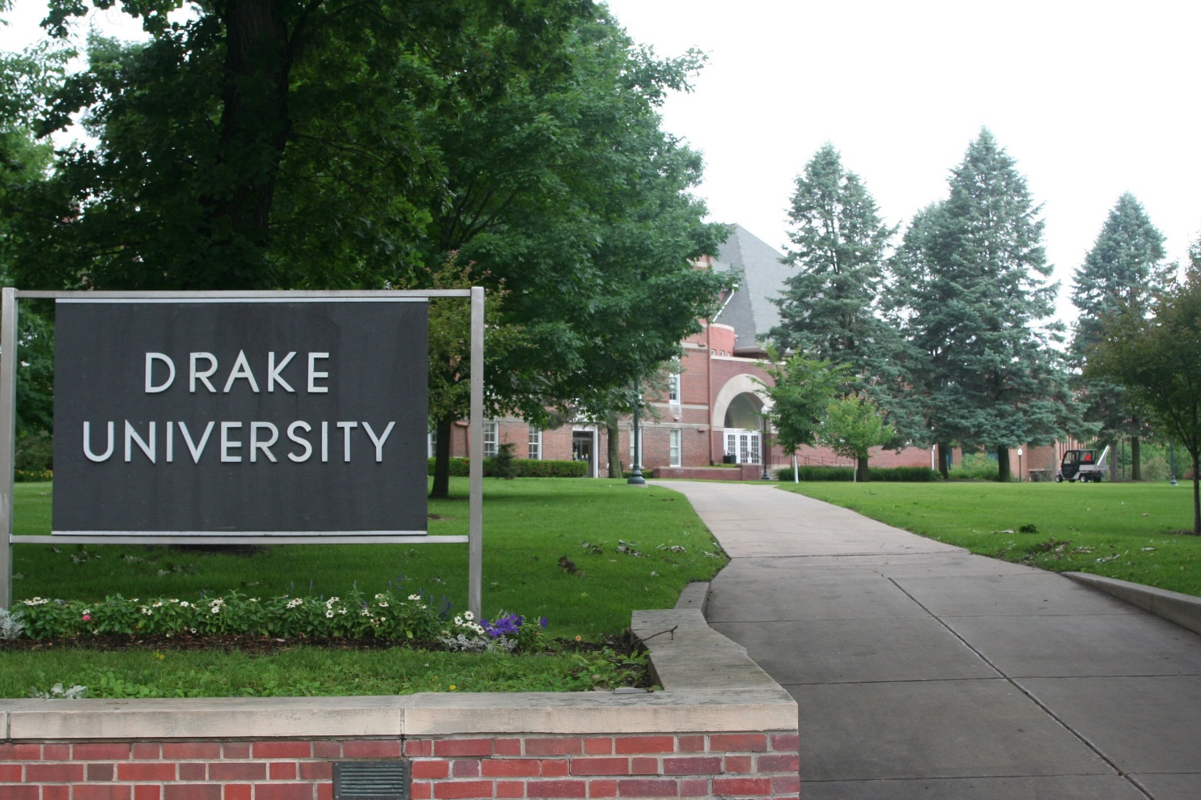
Hannah Richardson
Ally Vitko

Slide 8
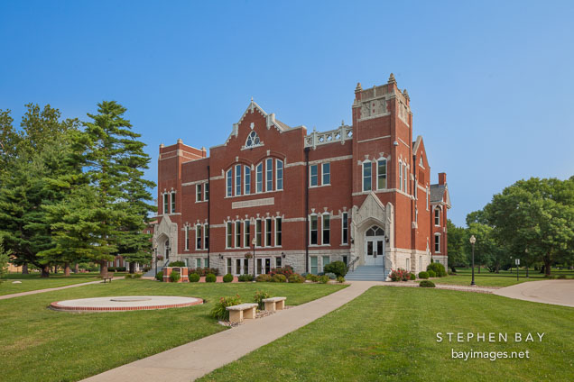
Sydney Cormeny

Slide 9
Esther Emberton

Slide 10
Jaylan Jones

Slide 11
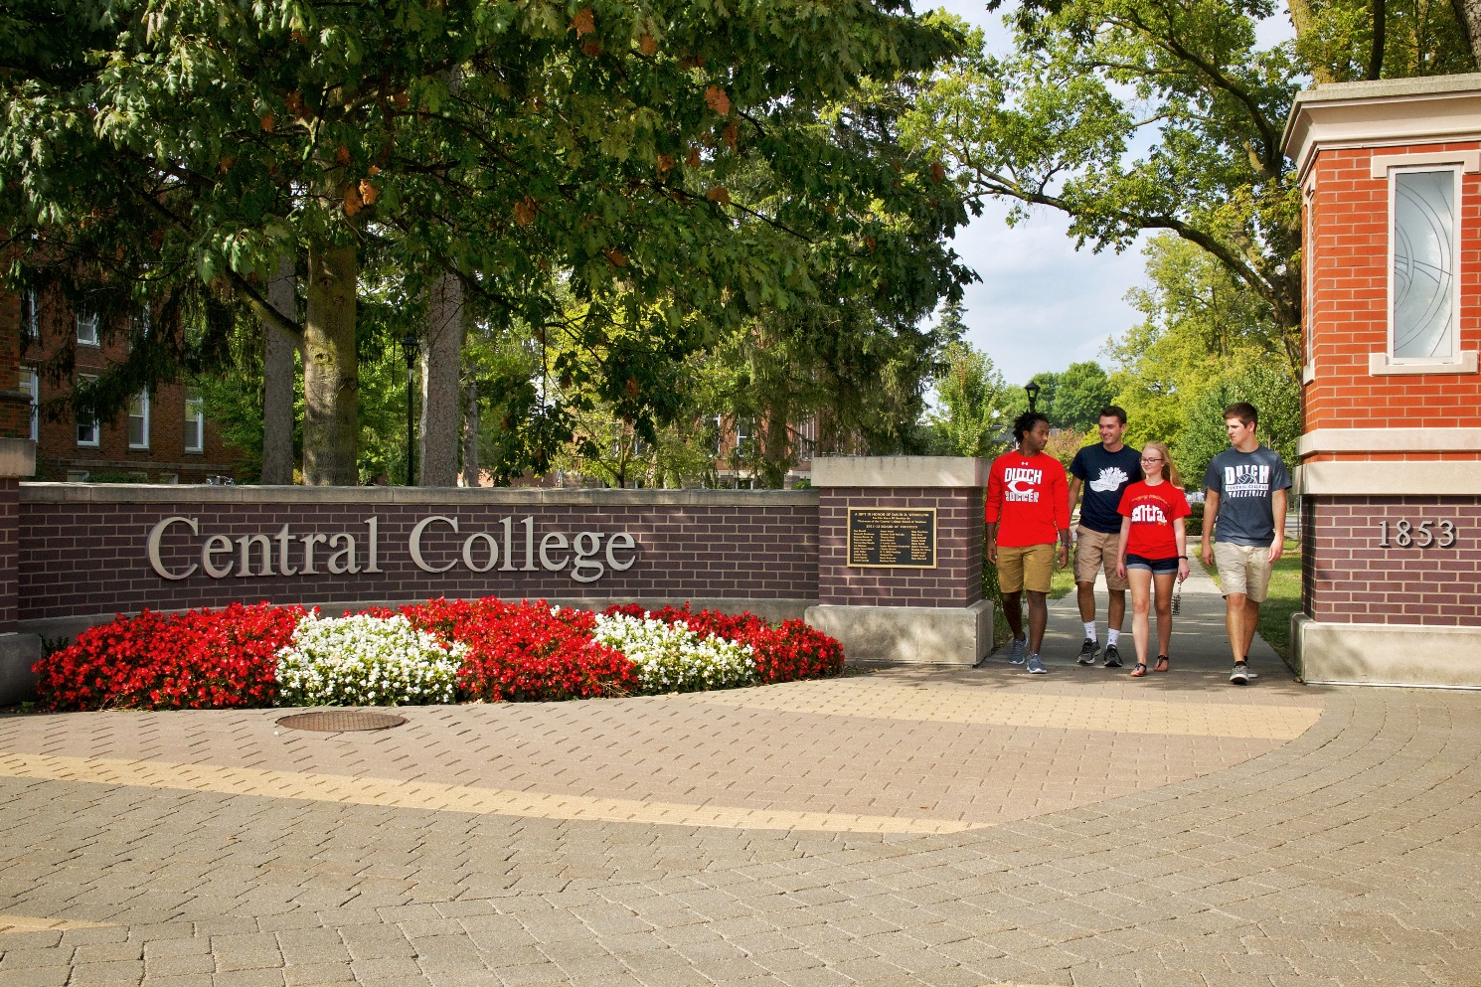
Devon Batterson

Slide 12
Monica Garcia

Slide 13
Alexis Luke

Slide 14
Keri Lipe

Slide 15
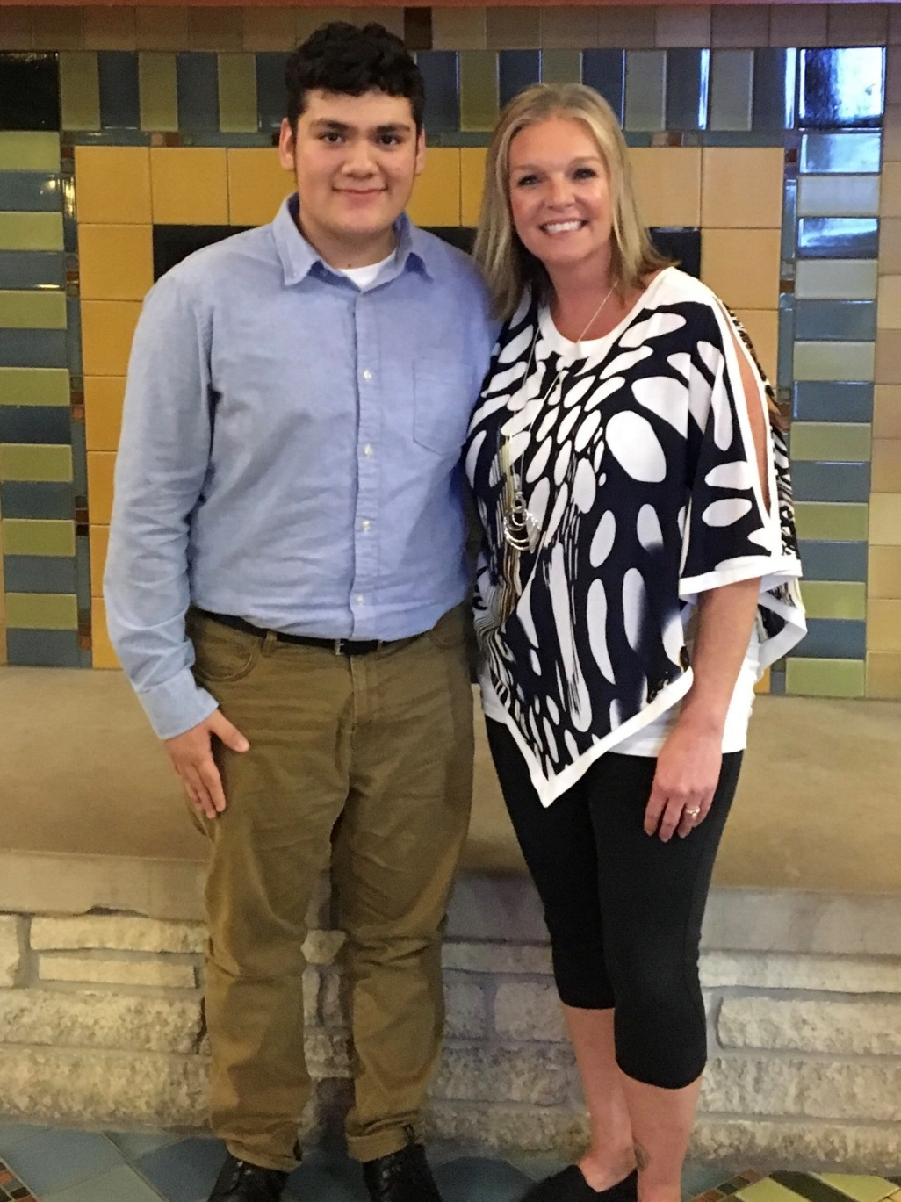
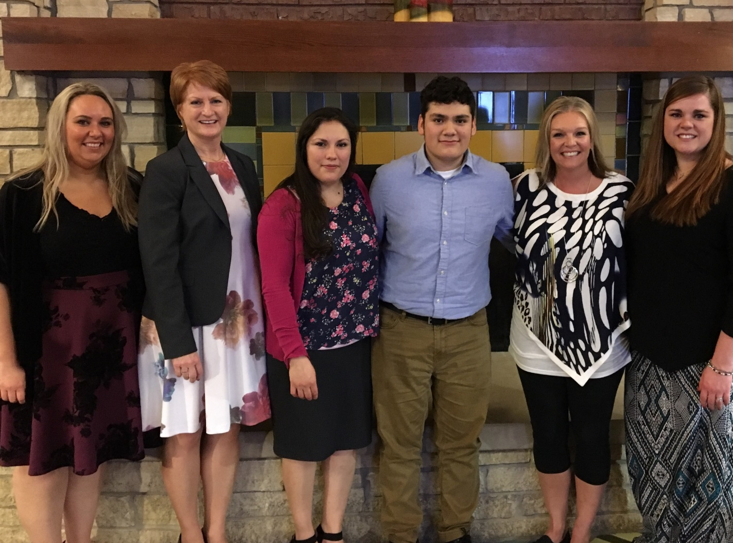
Wesley Melendez Iowa TRIO Board of Directors Scholarship Winner $1000

Slide 16
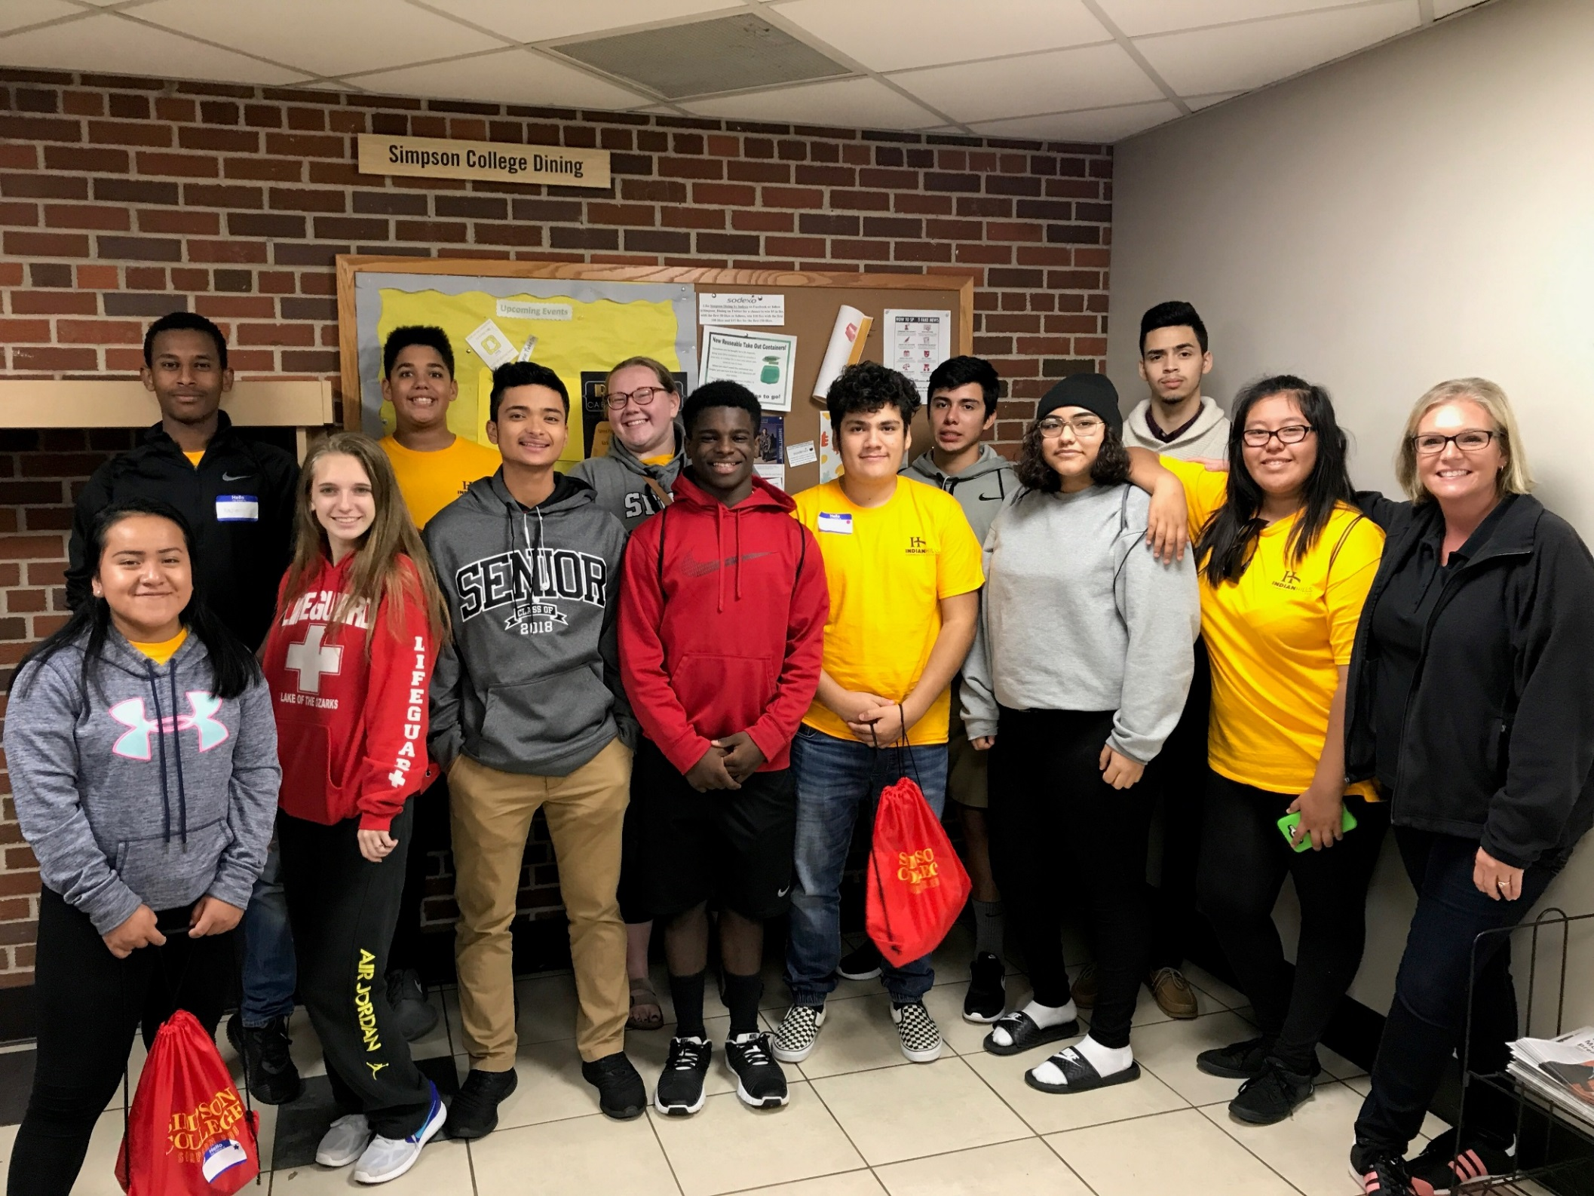
Student Leadership Conference-Simpson College-October 2017

Slide 17
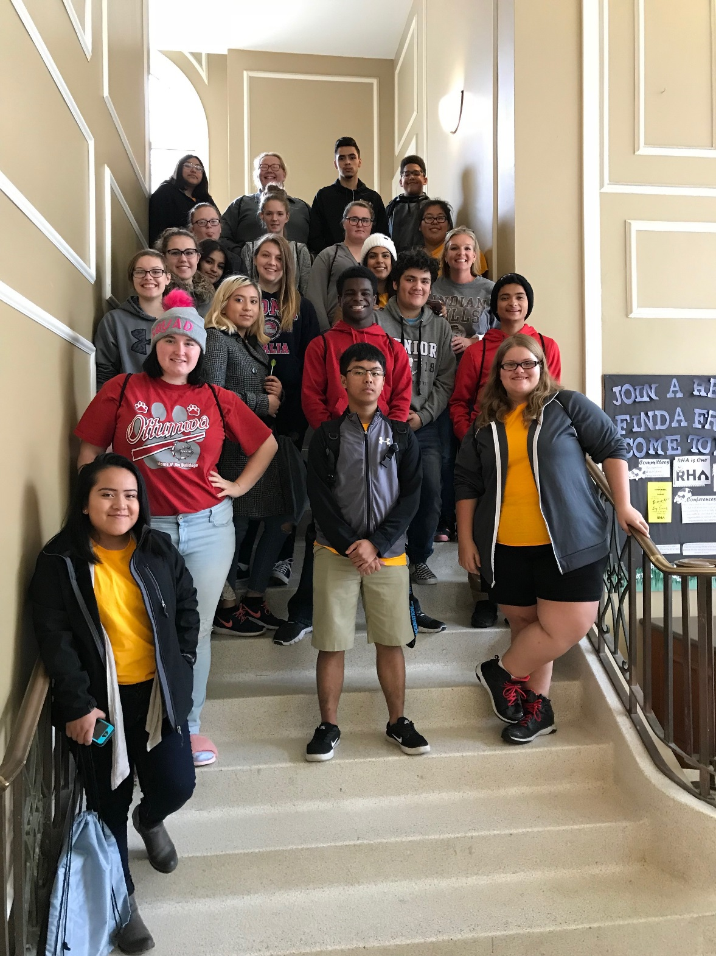
Truman State University
Kirksville, MO
Fall 2017

Slide 18
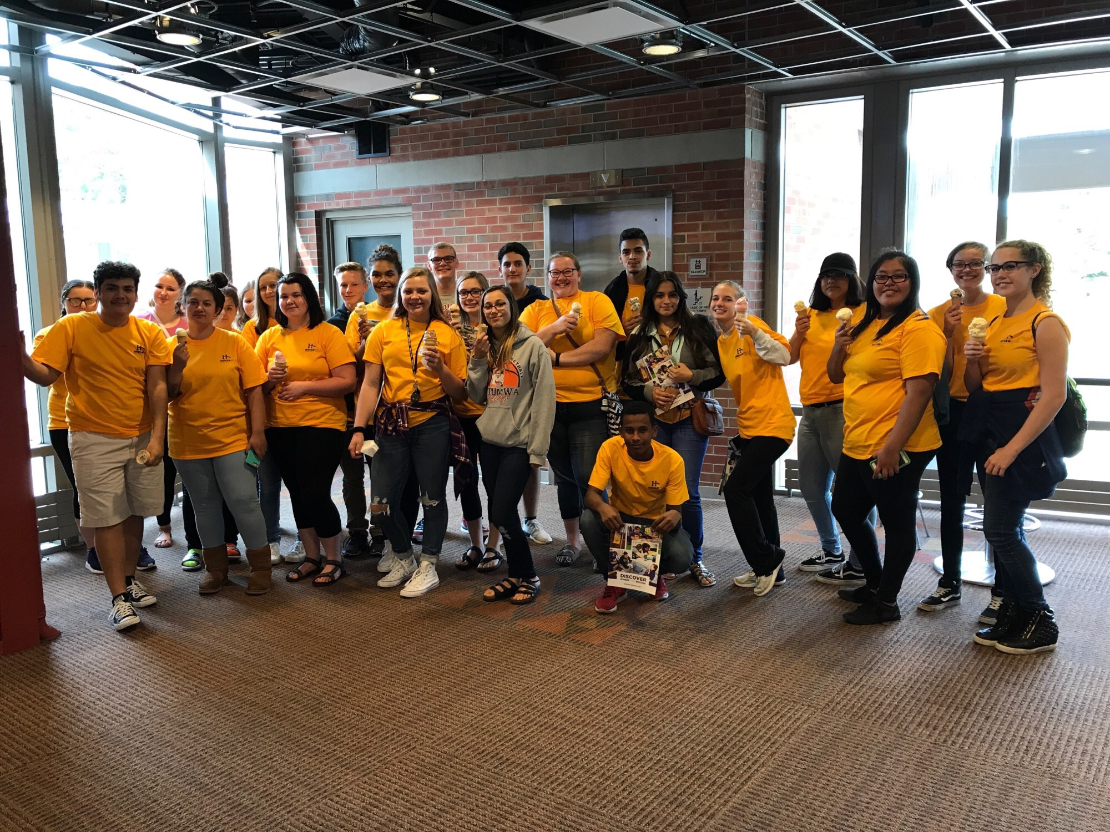
University of Northern Iowa
Fall 2017

Slide 19
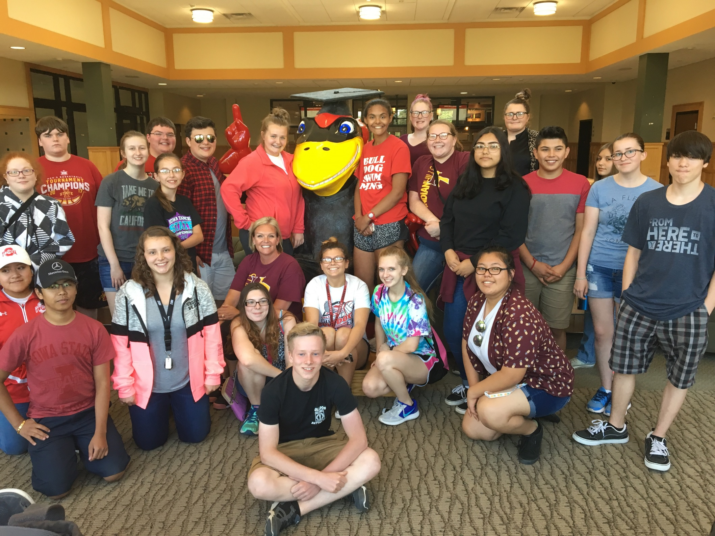
Iowa State University
Summer 2017

